Slide 1

Cerulean Circle
The platform for Earth Observation Common Architecture @ ESA

Slide 2
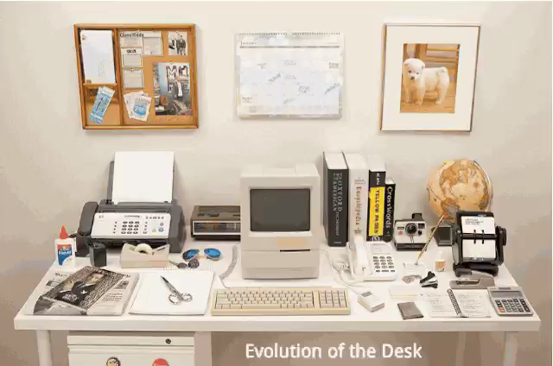
25 years of software eating the world

Slide 3
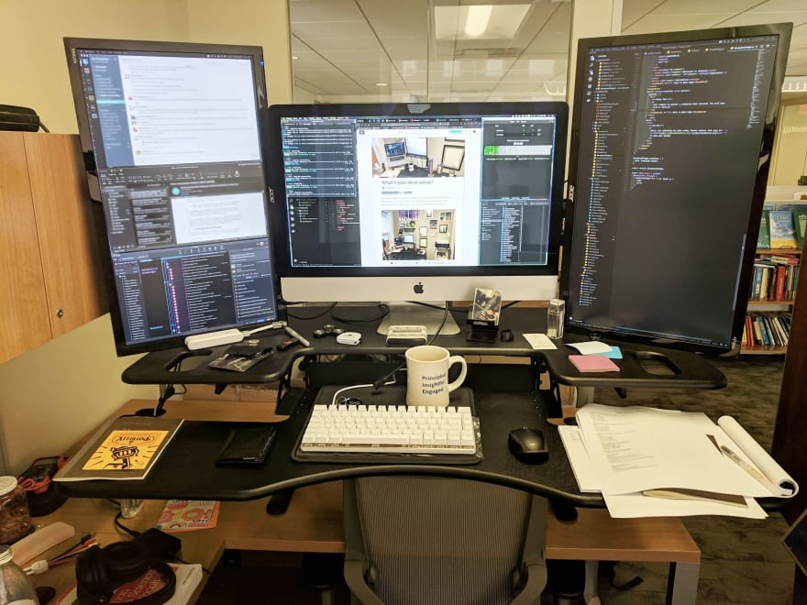
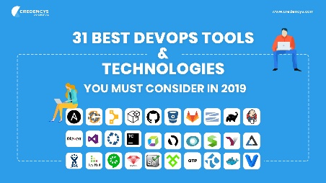

The people who brougt us here: Developers
The complex and sad workplace of developers today

Slide 4
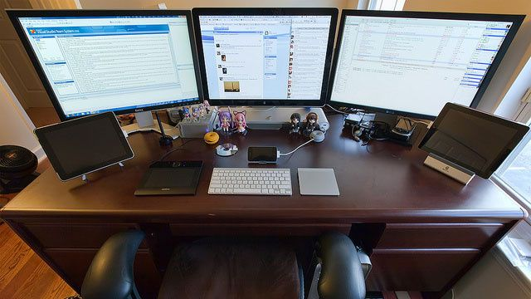
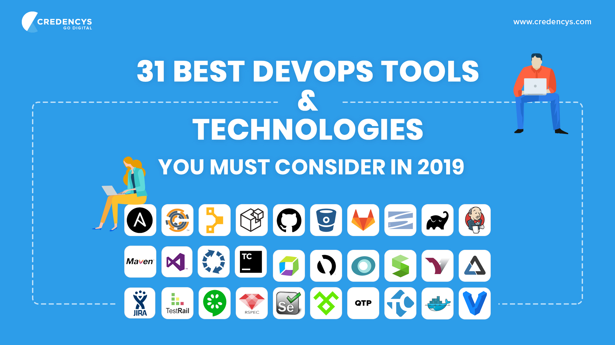

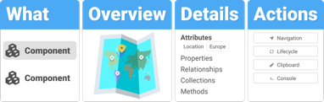


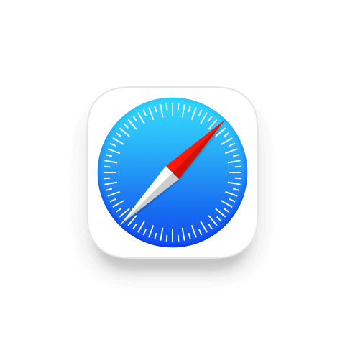



Lets make finally their live better, easier and more cleaned up!

Slide 5
Now lets wodafy the Internet of Every Thing until once it speaks Thinglish

Slide 6
We Drive the Market Place for
Digital Transformation
With ONCE it is possible for the first time to create Software which runs in every common environment.
Write ONCE Deploy Anywhere.

Slide 7

Cerulean Circle’s “ONCE” is the next logical step in software:
From individual coding to collaborative development
An Investment multiplies the outcome
The demand is obvious and it's just about the right time
ONCE leads to highly scalable business
Proof of concept
Investment requirements
CERULEAN CIRCLE
Write Once – Deploy Anywhere

Slide 8
Contradicting targets of Java Specialists
Provide pure business view
Control the pure technical environment to fit business requirements
OO Models maybe in UML are the master
Solution: expose to best praxis technical representation and tune by configuration

Slide 9
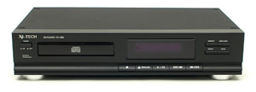
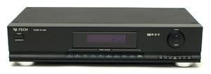
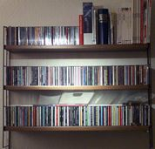
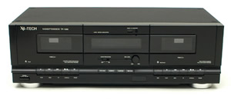

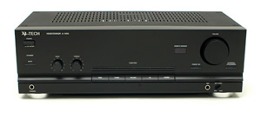

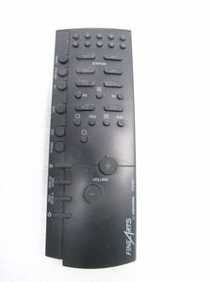
Contradicting targets of Java Specialists Provide pure business view
The business view is aligned with the business reality. OO is made to reflect reality:
A simple example, which everybody knows from at home. The business view is not interested in the technical details.
It’s interested in the contracts: what to provide and
what to receive.
It’s driven by resources, results and fulltime of targets.

Slide 10
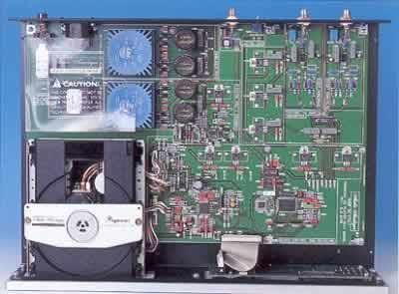
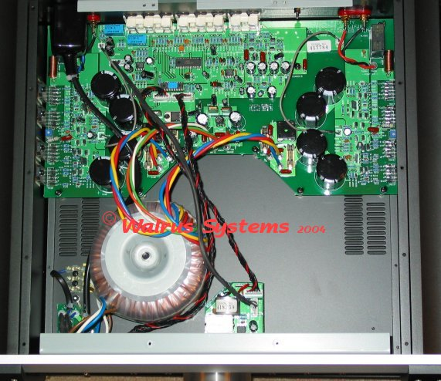
Contradicting targets of Java Specialists Control the pure technical environment
Reality Reality
Technology
Views
Graphical User Interface
Remoting
Network
Events
Controler
&
Components
Model
XIC
Datastore

Slide 11
Setup Top Down Project
Setup empty DB
Setup Java Business Model
  Java Project in JavaIDE
Setup Top Down Project
  Create Studio project for existing java project
  Define the persistent classes
  Specify the features you want to use

Slide 12
Setup Top Down Project
Setup empty DB
Setup Java Business Model
  Java Project
    Martin Fowlers SOA Structure
  Transportable Domain Model
    OO Entities
    Mention native SDO

Slide 13
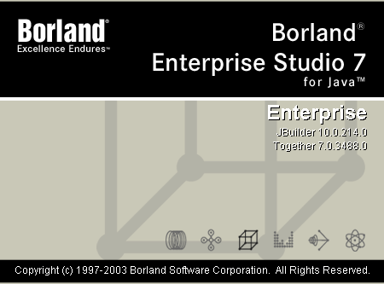
Project has to be created in a Java IDE
Studio is not a full Java IDE

Slide 14
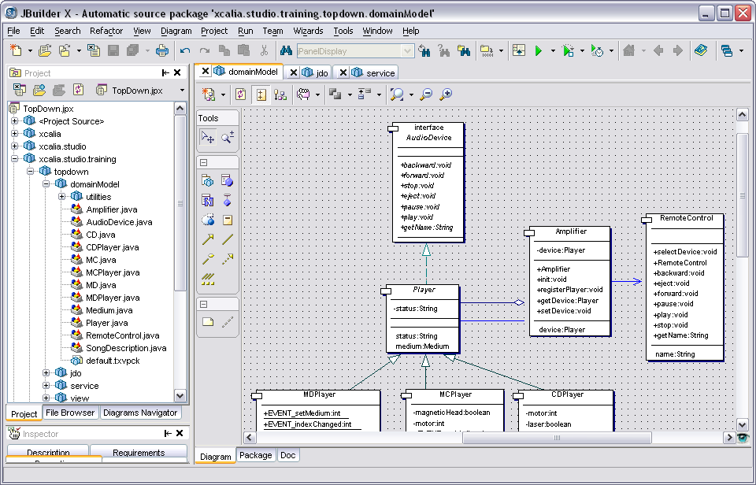
Project has to be created in a Java IDE
UML Model of the HiFi System

Slide 15
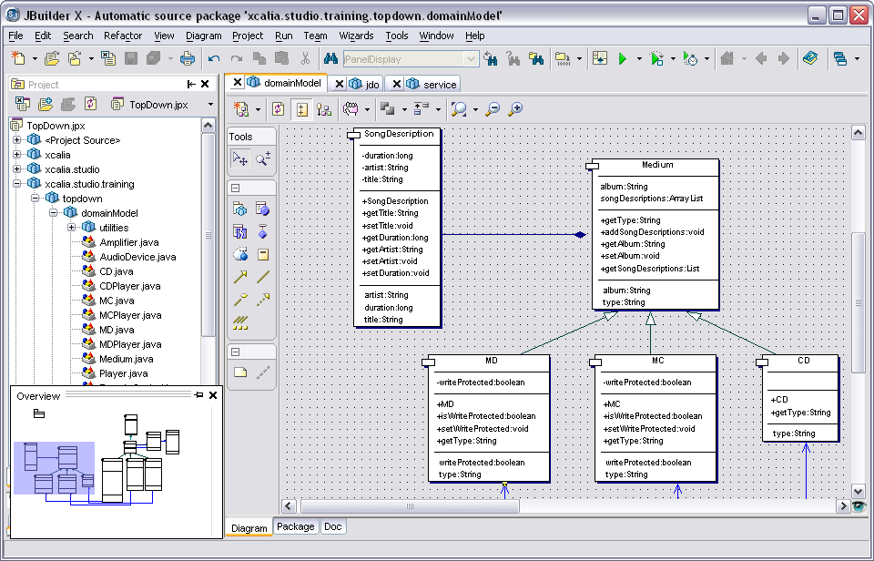
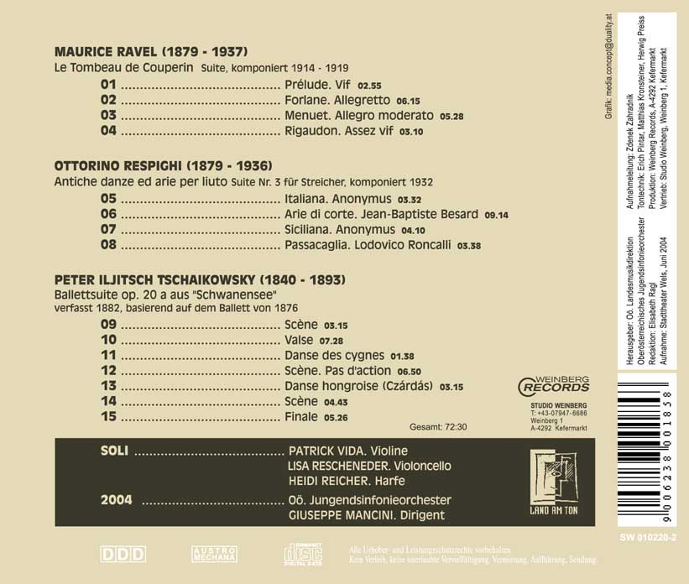
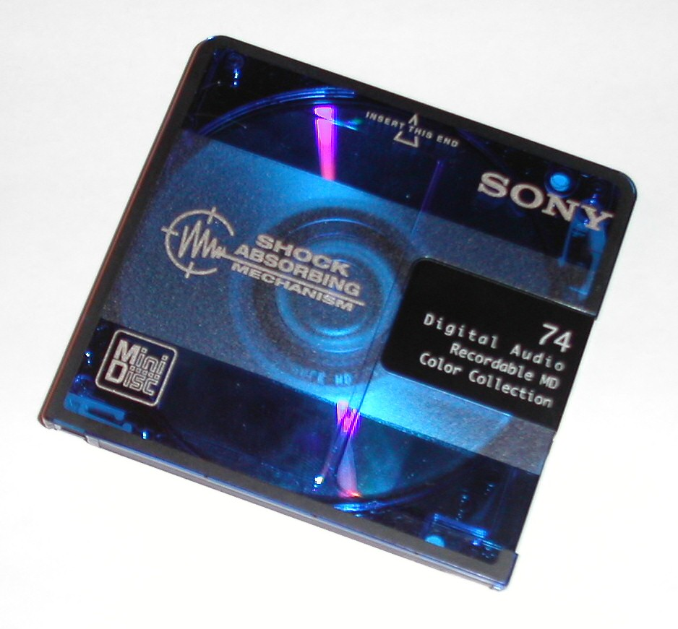
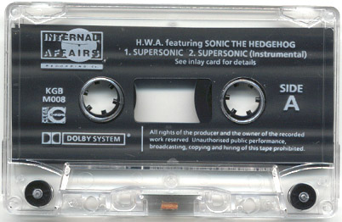
Project has to be created in a Java IDE
UML Model of the persistent backend

Slide 16

Setup Top Down Project
Xcalia Studio
Model
XIC
Datastore

Slide 17
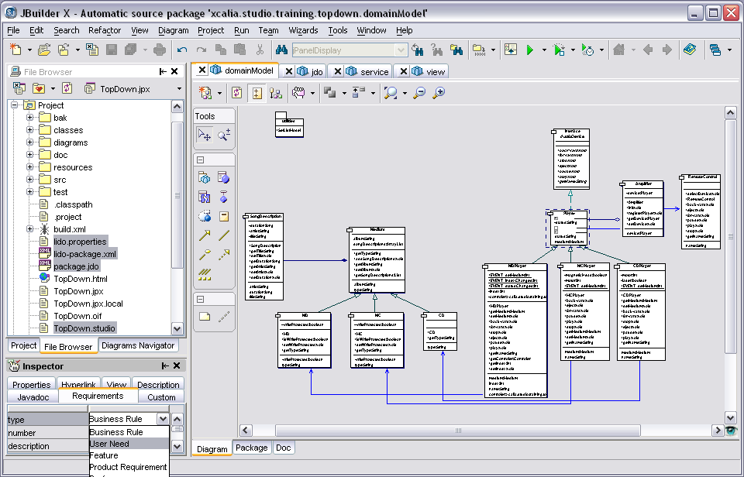
Project has to be created in a Java IDE
The resulting java project structure

Slide 18
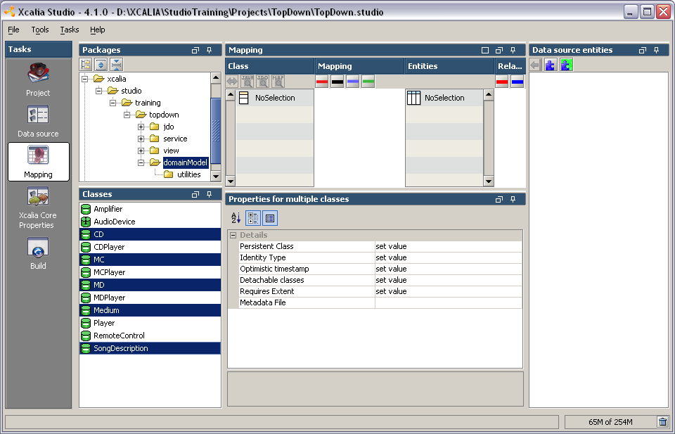
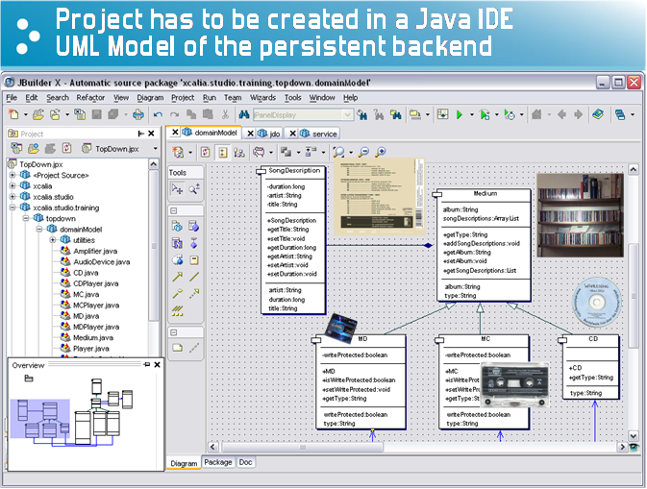
Define the persistent classes

Slide 19
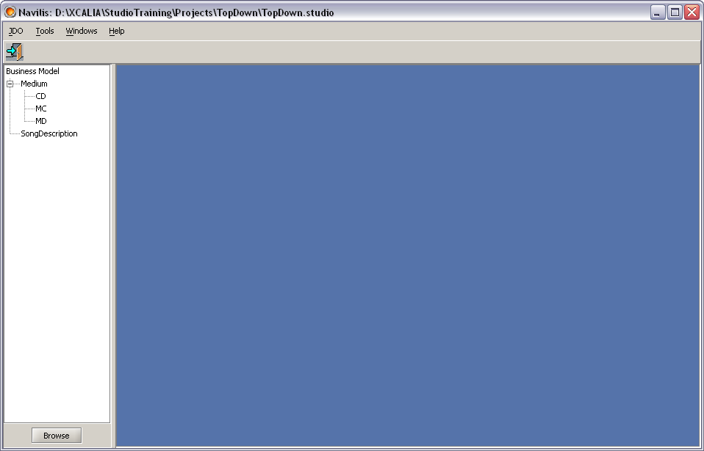
Test with Navilis
Create some initial Data

Slide 20
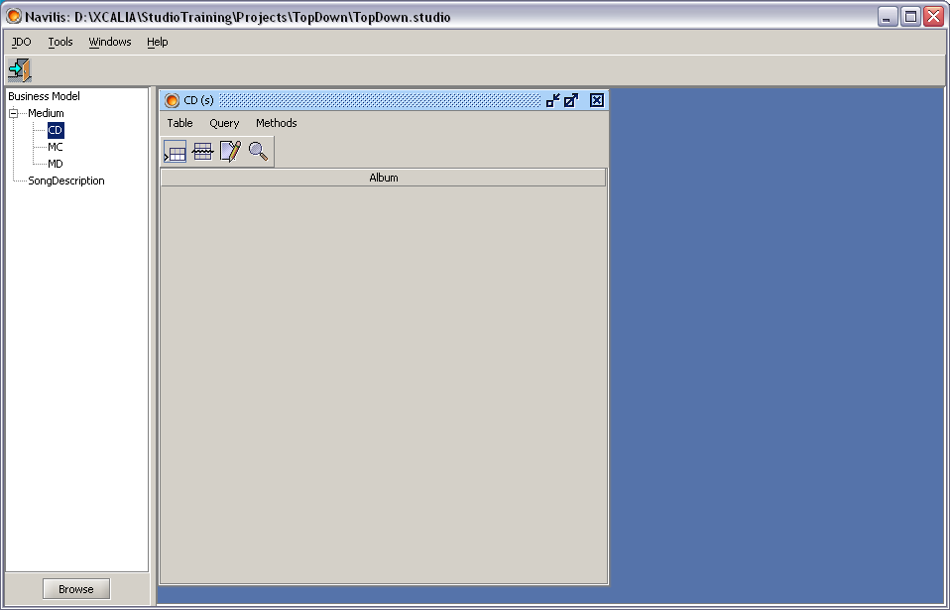
Test with Navilis
Create some initial Data

Slide 21
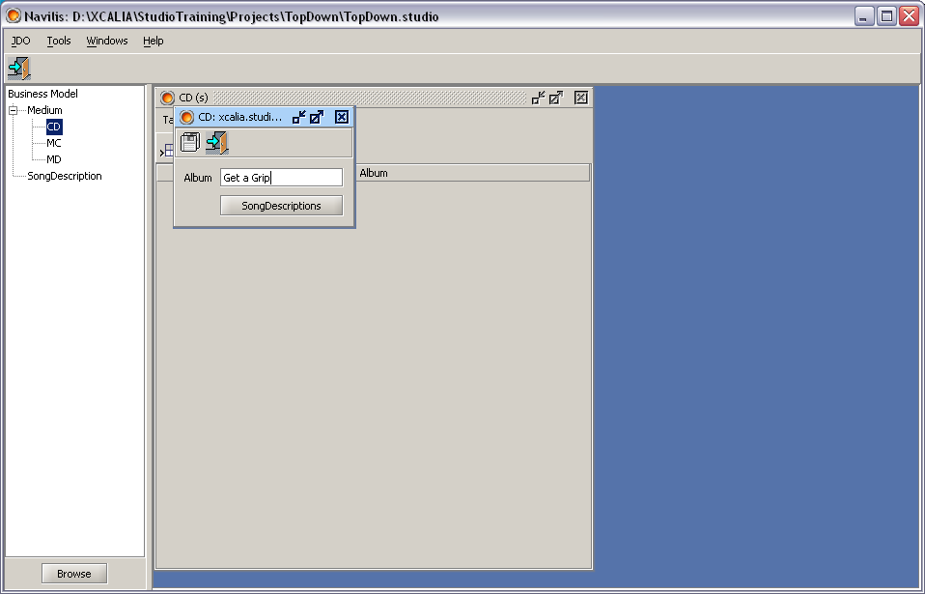
Test with Navilis
Create some initial Data

Slide 22
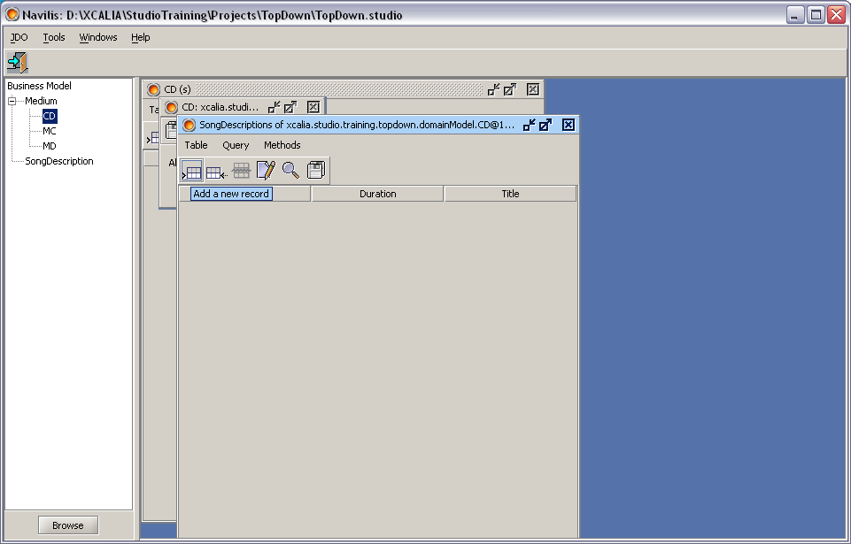
Test with Navilis
Create some initial Data

Slide 23
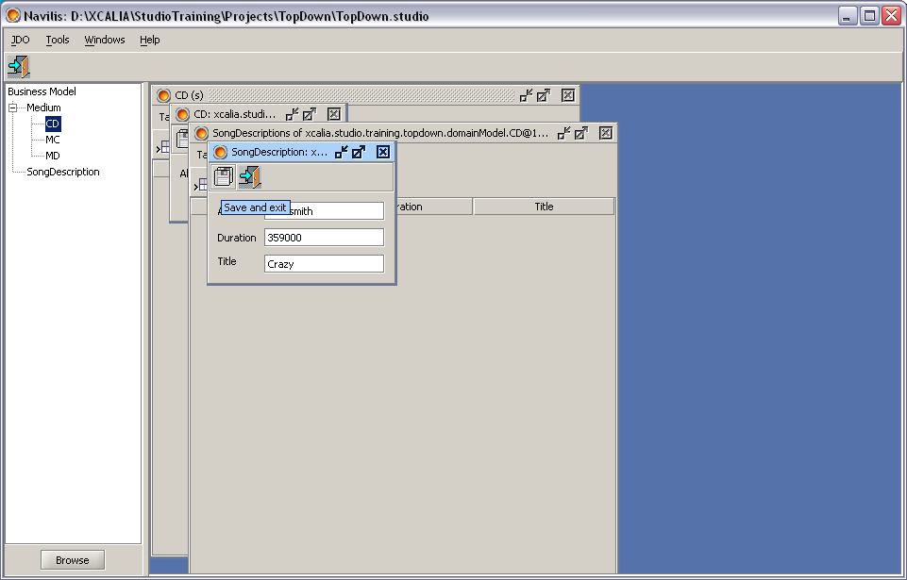
Test with Navilis
Create some initial Data

Slide 24
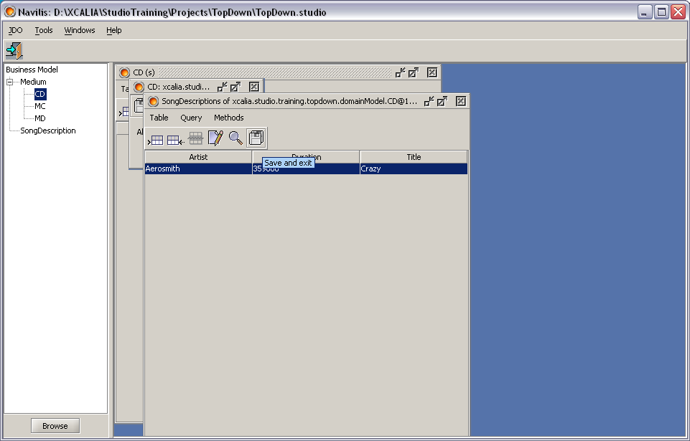
Test with Navilis
Create some initial Data

Slide 25
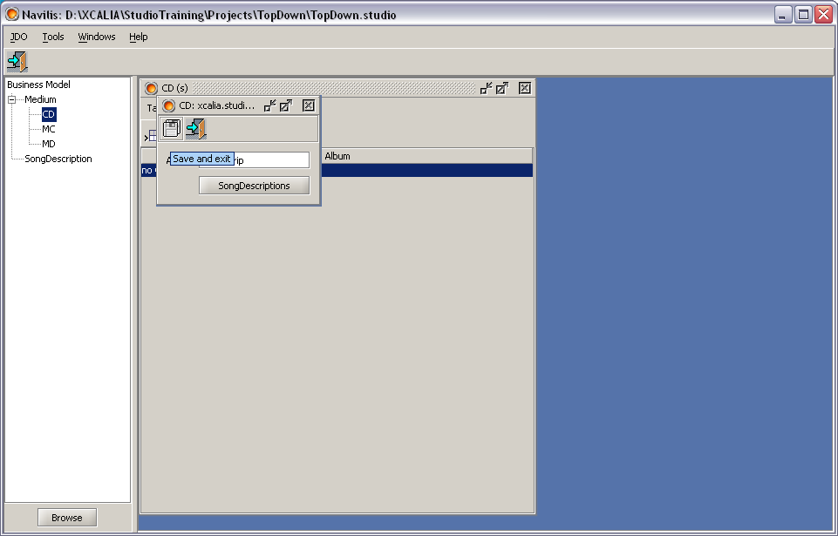
Test with Navilis
Create some initial Data

Slide 26
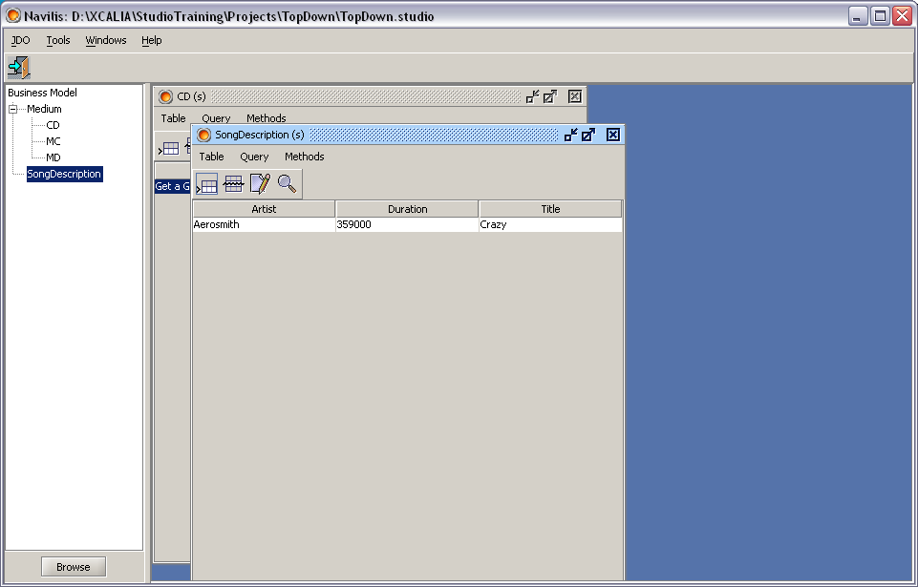
Test with Navilis
Create some initial Data

Slide 27
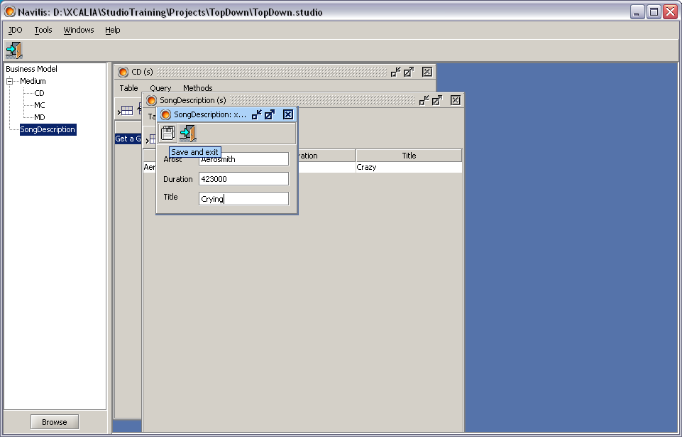
Test with Navilis
Create some initial Data

Slide 28
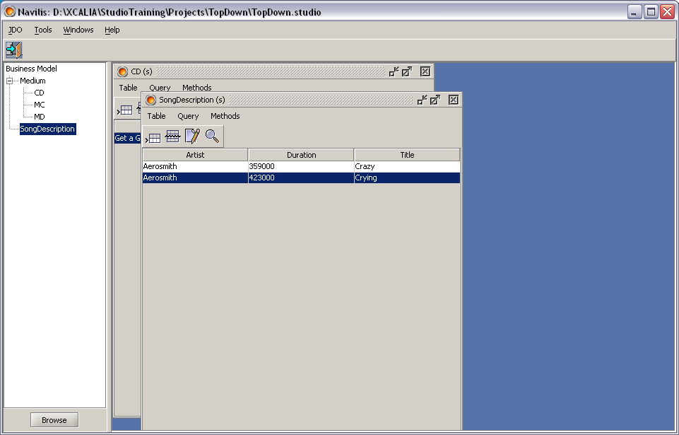
Test with Navilis
Create some initial Data

Slide 29
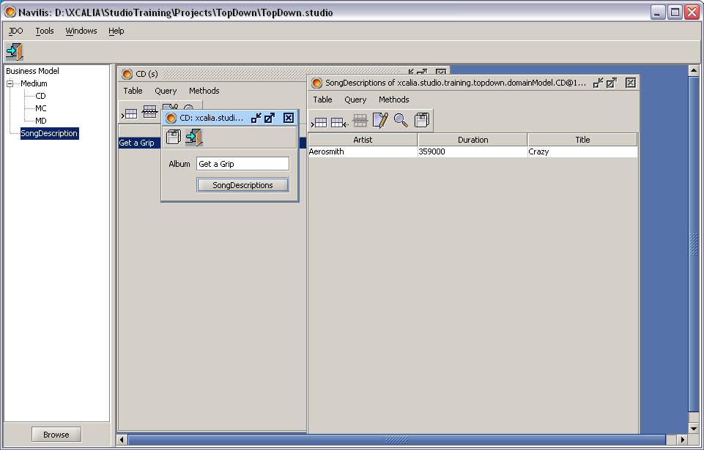
Test with Navilis
Create some initial Data

Slide 30

Test with Navilis
Create some initial Data

Slide 31
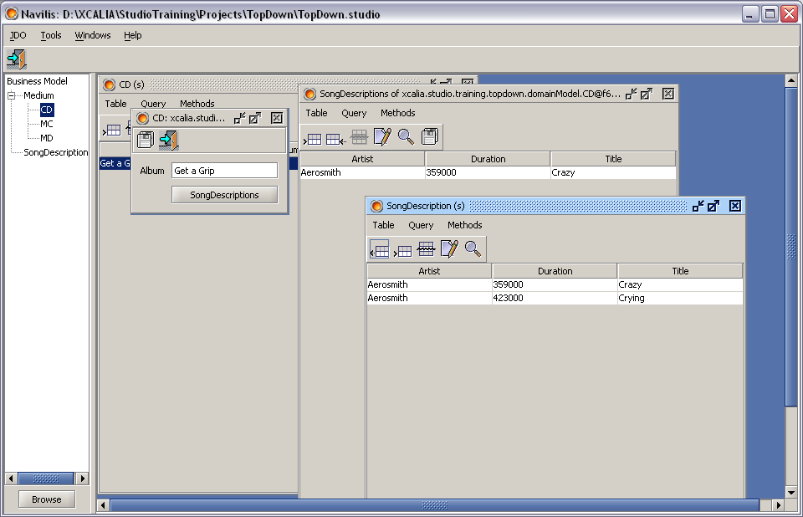
Test with Navilis
Create some initial Data

Slide 32
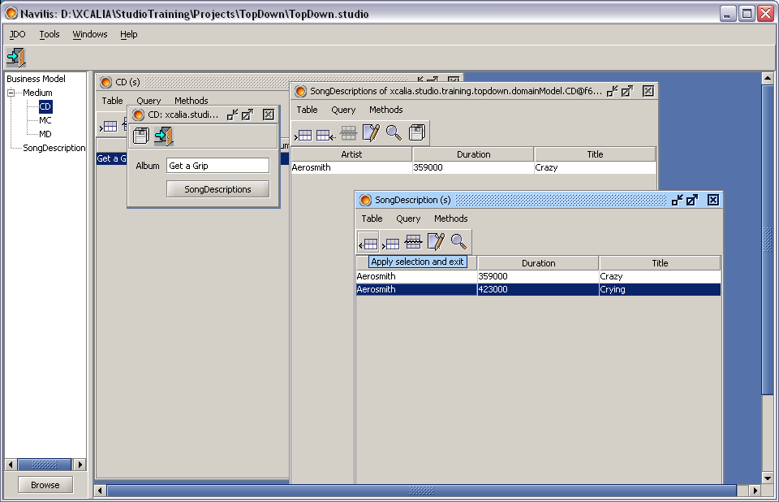
Test with Navilis
Create some initial Data

Slide 33
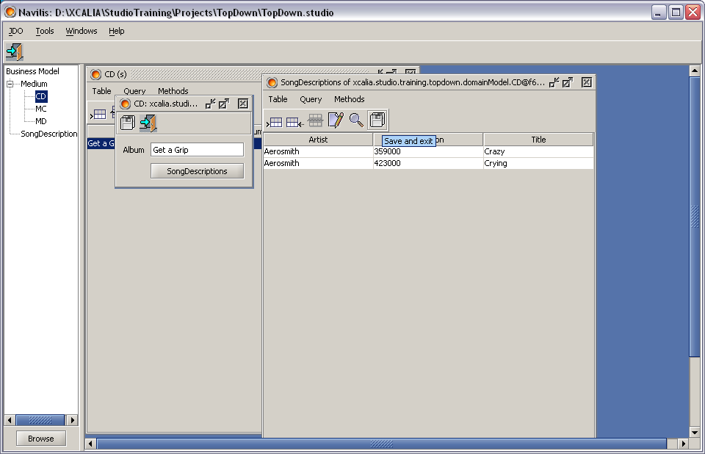
Test with Navilis
Create some initial Data

Slide 34
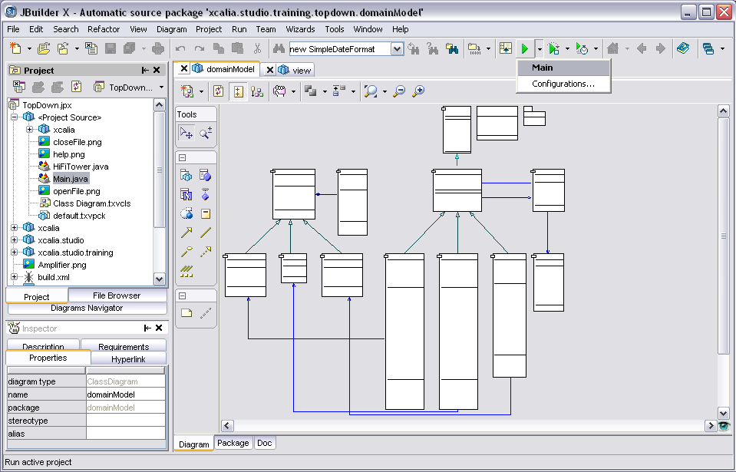
Test with HiFi Tower

Slide 35
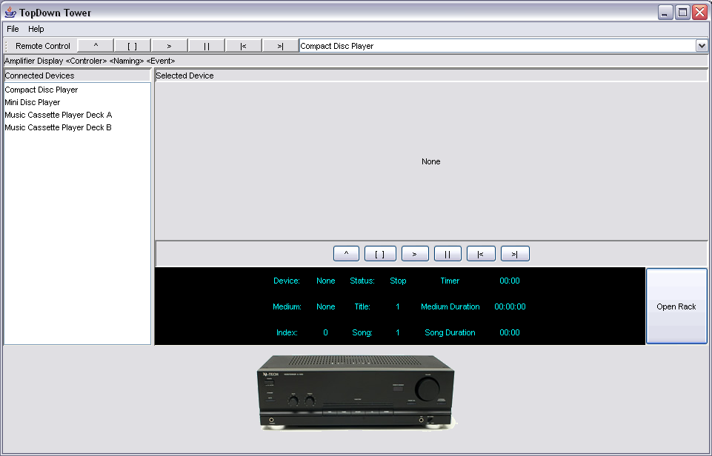
Test with HiFi Tower

Slide 36
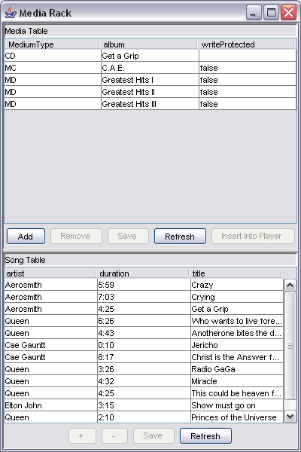
Test with HiFi Tower

Slide 37
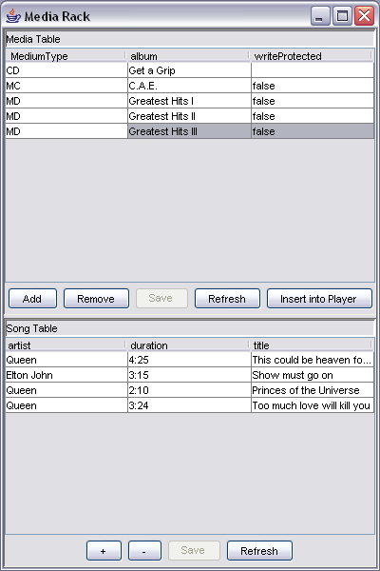
Test with HiFi Tower

Slide 38
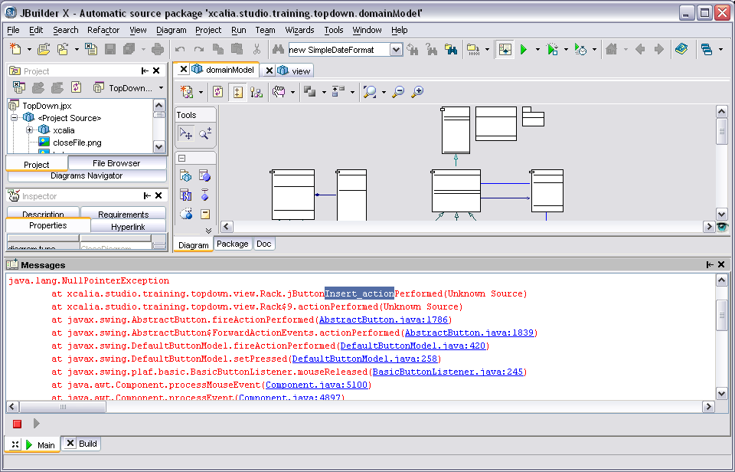
Test with HiFi Tower

Slide 39
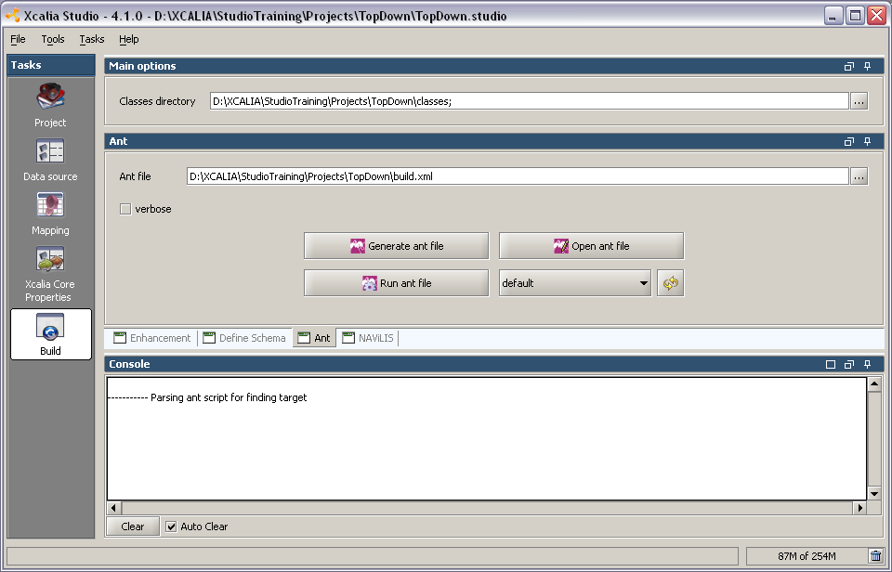
Test with HiFi Tower
Studio by default generates no Debug info

Slide 40
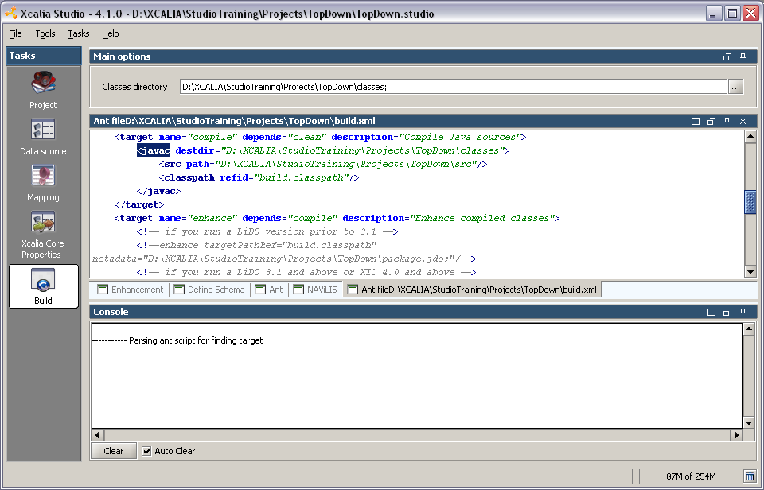
Test with HiFi Tower
Look into generated Ant file

Slide 41
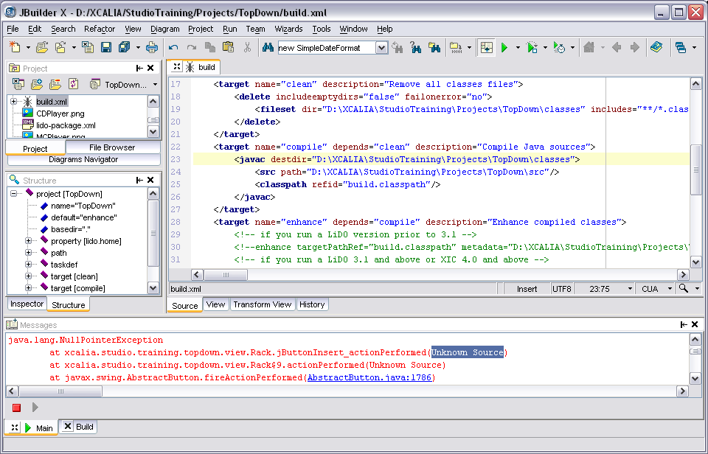
Test with HiFi Tower
Look into generated Ant file

Slide 42
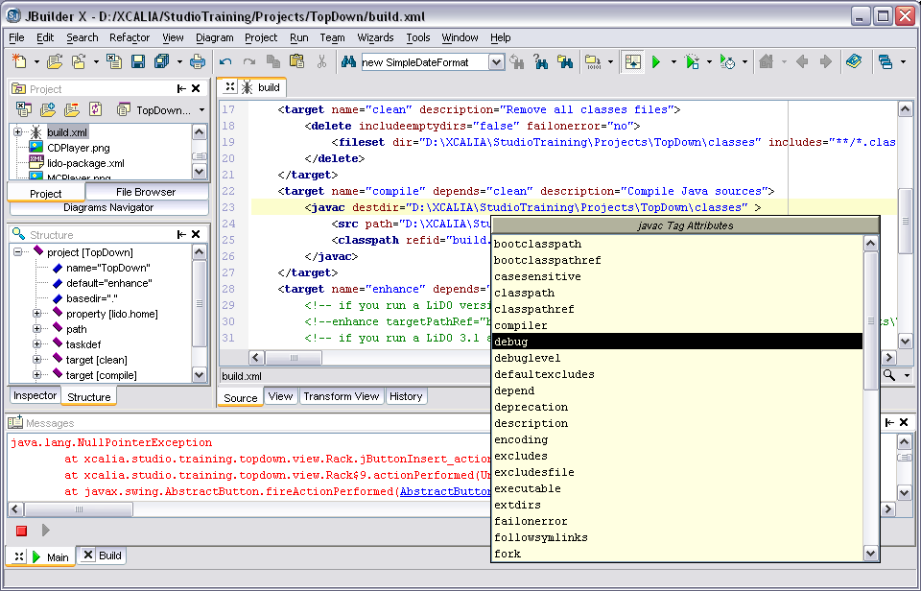
Test with HiFi Tower
Change the generated Ant file

Slide 43
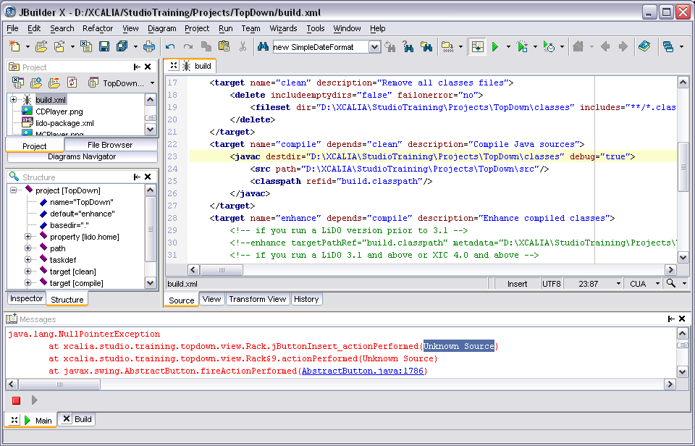
Test with HiFi Tower
Now Ant will add Debug infos

Slide 44
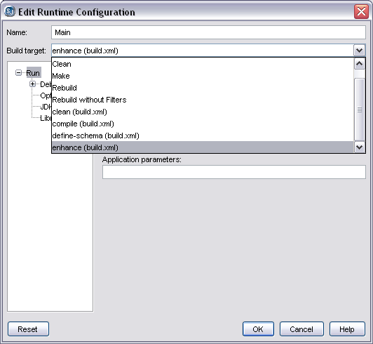
Test with HiFi Tower
Execute enhance task before every start

Slide 45
Test with HiFi Tower
Run again

Slide 46
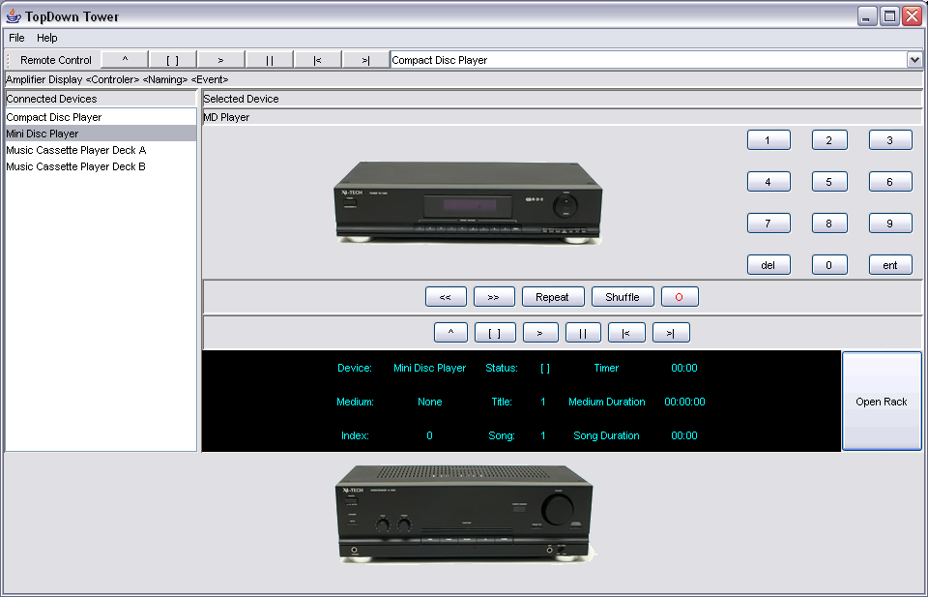

Test with HiFi Tower
Insert MD again into MD Player

Slide 47

Test with HiFi Tower
With Debug information

Slide 48
Test with HiFi Tower
Understand what’s going on
Reality Reality
Technology
Views
Graphical User Interface
Remoting
Network
Events
Controler
&
Components
Model
XIC
Datastore

Slide 49


Test with HiFi Tower
Understand what’s going on
ControlerService
contains views to models
NamingService
contains list of all important domain model objects
MDPlayerView
Rack <View>
jButtonInsert_actionPerformed
Domain Model
AmplifierView
namingService.lookup("Amplifier");
Amplifier
.getDevice()
getSelectedMedium()
DisplayView
MDPlayer
MD
getControler().fireEvent(this,
DisplayEvents.EVENT_setMedium);
.setMedium( )
Views
Graphical User Interface
Remoting
Network
Events
Controler
&
Components
Model
XIC
Datastore

Slide 50

Test with HiFi Tower
Understand what’s going on

Slide 51
Test with HiFi Tower
Understand what’s going on

Slide 52

Test with HiFi Tower
Understand what’s going on

Slide 53

Test with HiFi Tower
Understand what’s going on

Slide 54

Test with HiFi Tower
Understand what’s going on

Slide 55

Test with HiFi Tower
Understand what’s going on

Slide 56

Test with HiFi Tower
Understand what’s going on

Slide 57

Test with HiFi Tower
Understand what’s going on

Slide 58


SOA regarding to Martin Fowler
Domain Model
Notes:
More technical descriptions are not easy to understand by everyone. Relation to business seems to be unclear. Benefits are not obvious.
(
http://www.martinfowler.com/eaaCatalog/domainModel.html,
http://www.martinfowler.com/eaaCatalog/transactionScript.html,
http://www.martinfowler.com/eaaCatalog/serviceLayer.html,
http://www.martinfowler.com/bliki/AnemicDomainModel.html
)

Slide 59

Test with HiFi Tower
Understand the HiFi SOA
Services
Data
Services
Controler
Service
Naming
Service
MDPlayerView
Infrastructure
Server
Domain Model
AmplifierView
DisplayView
MD
Views
Graphical User Interface
Remoting
Network
Events
Controler
&
Components
Model
XIC
Datastore

Slide 60
Test with HiFi Tower
Understand the HiFi SOA
Services
Data
Services
Controler
Service
Naming
Service
MDPlayerView
Infrastructure
Server
Domain Model
AmplifierView
DisplayView
MD
Views
Graphical User Interface
Remoting
Network
Events
Controler
&
Components
Model
XIC
Datastore

Slide 61
Test with HiFi Tower
Understand the HiFi SOA
Services
Data
Services
Controler
Service
Naming
Service
MDPlayerView
Infrastructure
Server
Domain Model
AmplifierView
pm.currentTransaction().begin();
{
Collection online = pm.newQuery(
MD.class).execute();
online = pm.retrieveAll(online)
}
pm.currentTransaction().commit();
detached=pm.detachCopyAll(online);
DisplayView
MD
Views
Graphical User Interface
Remoting
Network
Events
Controler
&
Components
Model
XIC
only default
fetch group
Datastore

Slide 62

Test with HiFi Tower
Understand the defaultFetshGroup

Slide 63

Test with HiFi Tower
Small checkbox, big impact

Slide 64

Test with HiFi Tower
Understand the defaultFetshGroup
Services
Data
Services
Controler
Service
Naming
Service
MDPlayerView
Infrastructure
Server
Domain Model
AmplifierView
pm.currentTransaction().begin();
{
Collection online = pm.newQuery(
MD.class).execute();
online = pm.retrieveAll(online)
}
pm.currentTransaction().commit();
detached=pm.detachCopyAll(online);
DisplayView
MD
Views
Graphical User Interface
Remoting
Network
Events
Controler
&
Components
Model
now in default
fetch group
XIC
Datastore

Slide 66

Test with HiFi Tower

Slide 67
Test with HiFi Tower

Slide 68

Test with HiFi Tower

Slide 69

Test with HiFi Tower

Slide 70

Test with HiFi Tower

Slide 71

Test with HiFi Tower

Slide 72

Test with HiFi Tower

Slide 73

Test with HiFi Tower

Slide 74

Test with HiFi Tower

Slide 75

Test with HiFi Tower

Slide 76

Test with HiFi Tower

Slide 77

Test with HiFi Tower

Slide 78

Test with HiFi Tower

Slide 79

Test with HiFi Tower

Slide 80

Test with HiFi Tower

Slide 81


Collection mapping approaches
Different schema, nearly no impact on App.

Slide 82

Collection mapping approaches
“reverse” Collections are unordered.

Slide 83


Tune Xcalia Intermediation Core™ by Properties e.g. start to play with the tracing modules

Slide 85
Learn to speak SOA: Terminology (15 min)
Paradigms
  Entities – OO – Components – Services
  Martin Fowler SOA
Entities
  OO Entities ( Domain Model )
  DB Entities
Services
  Data Services
  Process Services
Data Sources

Slide 86
Learn to speak SOA: Terminology Paradigms
a brief history of time
J2EE
Components
SOA
Services
E/R Model
Entities
CORBA
Objects
Person
Person
Services
Firma
Firma
1
<interface>
PersonHome
<interface>
PersonRemote
1
1
Person
Adresse
Person
Adresse
1
*
PersonImpl
relational
Database
Antragssteller
Versicherter
1980
1985
1990
1995
2000
Notes:
Service is mostly seen as a remote way to call a component.
But a service can also be seen as a local entry point to a semantic required for the business process. The remote aspect is still important but secondary.

Slide 87
Learn to speak SOA: Terminology Paradigms: SOA nach Martin Fowler
Domain Model
Notes:
While the domain model reflects the reality of a domain (business area) the service layer reflects the balck box character of the domain.

Slide 88

Learn to speak SOA: Terminology
OO Entities
OO is the only model which reflects reality easily
  look at your HiFi Tower at home
Notes:
explain interface concept
explain abstract class
explain service: remote control relies on AudioDevice interface
explain GUI: Display relies on Medium Interface
explain persistance class Medium and SongDescription
explain non persistent classes

Slide 89


Learn to speak SOA: Terminology
DB Entities
Which are the persistent classes
Notes:
explain interface concept
explain abstract class
explain service: remote control relies on AudioDevice interface
explain GUI: Display relies on Medium Interface
explain persistance class Medium and SongDescription
explain non persistent classes

Slide 90
Learn to speak SOA: Terminology
Data Service
Entitäten
Entities
Daten Services
Data Services
Antrag
<interface>
AntragService
Antrag
Services
Person
Adresse
Person
Services
AntragImpl
Antragssteller
Versicherter
Risiko
POJO
EJB
JDO
SDO
technical
UseCases
<Read>
Navigate
< Write >
Delete
<Read>
Find
< Write >
Update
<Read>
Present
<Write>
Create

Slide 91
Learn to speak SOA: Terminology
Process Service
  Requirement based UML (RBU)
Requirements
Use Cases
Activities
Entities
Antrag
address change
Person
Adresse
Req-42: Umzug
setAddress
Die Anforder-ung be-schreibt den Zustand der…
Versicherter zieht um
move
risk change
setRisk
Antragssteller
Versicherter
Risiko
step in
business process
automated
agile
business process
stable
Data
Service

Slide 92
Learn to speak SOA: Terminology
Data Sources
continuous business process
XIC™
relational
Database
xml
files
oo
Database
Services
Standard
Software
e.g. SAP
custom
Software
legacy
Software
e.g. Mainframe

Slide 93

Data source management
E/R Model recall
Order
Relationship
Product
OO Model
n
m
+ Attributes
+ Operations
normalization
Entity
Entity
Relationship
Order
OrderItem
Product
*
E/R Model
+ PK Attributes
1
*
*
1
+ Attributes
+ Indices
*
+ Checks
*
1
Cardinalities IDEF1X IE
  zero or more
  one or more (P)
  zero or one (Z)
  exactly
Entity
Customer

Slide 94

Mapping
OO ➔ E/R
Order
Relationship
Product
OO Model
0…*
0…*
+ Attributes
n
m
+ Operations
Association, Aggregation, Composition
  Storage Points
    Attributes, Properties
  Navigability
    unidirectional
    bidirectional
Client Supplier
Cardinality
  0…*
  1…*
  0…1
  1
Entity
Relationship
Entity
Order
OrderItem
Product
*
E/R Model
+ PK Attributes
1
*
*
1
+ Attributes
+ Indices
*
+ Checks

Slide 95

Mapping
OO ➔ E/R
Order
Relationship
Product
OO Model
0…*
0…*
+ Attributes
n
m
+ Operations
Inheritance Mapping
Hardware
Software
normalization
Entity
Entity
Relationship
Order
OrderItem
Product
*
E/R Model
+ PK Attributes
1
*
*
1
+ Attributes
+ Indices
*
+ Checks

Slide 96


Mapping
XML recall
Xcalia Studio internal data:
DOM
Document Object Model
java
source
files
compile
java
class
files
enhance
jdo
class
files
logical Entity Model
package
.jdo
validation
jdo.dtd
structure
physical mapping information
lido-
package
.xml
XCALIA\CORE\lib\
lido-
mapping
.xsd
structure & consistency
possible values and defaults
evaluated by Xcalia Studio for the editor fields

Slide 97



Build
Xcalia Build Tooling Concepts
sql
file
java
source
files
compile
java
class
files
enhance
jdo
class
files
define schema
Database
or
ddl
xml
files
standardized
output
enhancer
tool
define
shema
tool
ANT TASKs

Slide 98



Build
Xcalia Build Tooling Concepts
Notes:
Ant is the interface to the IDEs

Slide 99

Build
Xcalia Build Tooling Concepts
Notes:
Ant is the interface to the IDEs

Slide 100
Imagine you could develop a custom web application with just drag & drop from a component library in front of your cutomers eyes in real time
Imagine you would show the world, how truly M2M communication is working, technology and provider independent in an open architecture
Imagine you would have a web shop accessing an ocean of web components and every developer could buy, re-sell and extend them via Drag & Drop

Slide 101
The “Developer Gap” is the main challenge in software programming.
It costs millions and slows down the digital economy.
Exponential demand for Web Apps & Machine2Machine IOT
caused by continuous digitization + Covid 19 crisis (Moore's law)
1. The Developer Gap
  Lack of coding resources due to complexity and diversity of software platforms and systems
  Lack of specialists due to Industry 4.0 transition & extremely diverse technologies in IoT and cloud frameworks
  Lack of rewarding business models and incompatible ecosystems for programmers (democratization of software, disruption)
$ Costs
2. No Scale of Economy for Software Development, expensive linear efforts-based development costs (NRE)
  The incompatible diversity of current systems increases the development efforts and causes repeating and redundant developments
  Maintenance of old systems and migration to new technologies is very expensive or impossible

Slide 102
High value of ONCE & WODA for everybody who creates or purchases software: “Write Once Deploy Anywhere”
ONCE & WODA
Enables true collaboration of the coder community with compatible & interchangeable software components
Enables re-use of software components, minimizing coding and maximizing output & quality
Enables to create software with drag & drop which runs in any common system environment
Write Once Deploy Anywhere (true Progressive Web Apps = PWA)
Enables multiple app-stores for closed and open communities (meaning external and global shops)
-> recurring business models!
A progressive web app development of 4x6 man-months
is reduced to 2x3 man-month by reusing components with drag & drop
development efforts & cost reduction by >75%

Slide 103



Imagine you would have an App Store with thousands of Components and every developer could buy, re-sell and create new Apps via Drag & Drop
ONCE: just one line of code implements a 135 KB kernel which can
work on any device or system environment.
WODA is an integrated development environment allowing to produce
software by drag and drop using components.
EAMD.ucp is a distributed software repository for components & apps enabling stores & communities.
B2B Customer
User App
Customer WODA System
Local & Cloud
<script src="/EAMD.ucp/Components/tla/EAM/layer1/Thinglish/Once/2.0.0-ONE/src/js/Once.class.js"type="text/javascript"></script>
Assets
User App
EAMD.ucp Repository
Services, Stores, Apps
WODA Application

Slide 104
High Value of ONCE & WODA for Global Service Companies with close Cooperation Partner Deloitte
Deloitte Shop
Use our virtual control units and pay less than 1 Euro per I4.0 connected devices yearly. There are 100 Mio. connected I4.0 devices, worldwide… Siemens alone has 5000+ customers in Germany
Every IoT device would use our free component library to connect to a licensed business service. 1 cent per device per business service with a market volume of 46 billion devices
Use our web component store and pay less than 1 Euro per component per webpage yearly. There are 1,744 Mio. webpages, worldwide …
Deloitte development
Reduce the software development time of Deloitte Digital Projects (and others) by 75% and increase the client hourly rate by +25%. Potential to grow up to 5 Mio. Euro yearly. Deloitte DE wide has a potential of up to 30-50 Mio. Euro
“Even if we reach only 10% of the market, the business can be more than 100 million/year
Deloitte DE wide value in R&D is 30-50 Million”.
(Source Deloitte Digital GmbH confidential)

Slide 105
Based on its validation Deloitte will act as the main sales & marketing and development Partner
Joint Go to Market Strategy
Finalize Developments for Deloittes commercial use within 12-18 Months
Execute joint Training- and Certification Plan for Developers to grow Developer Community
Start internal development projects as reference for Customer Acquisition
Launch of Deloittes Store DDCAST in Q1 2023
Deloitte rollout according to 3 years Revenue Plan starting Q1 2022
Deloitte will use WODA and ONCE as their competitive advantage for its Digital Business
(Deloitte Digital GmbH Cooperation-Contract with Cerulean Circle confidential)

Slide 106

Triple Win business advantage for our Partners & Cerulean Circle
Subscriptions, Shop Revenues and Recurring License Fees
Recurring Revenues cumulate and grow with increasing user base for our partners, resellers & Cerulean Circle
Subscriptions (usage based on own and partner Apps)
COAST Revenue (Cerulean Circle Store)
Revenue share (Partner Portal Revenue)
Royalties (per ONCE activation)
Small Enterprise License (yearly)
Large Enterprise License (yearly)
Managed Hosting
R&D Project Revenues are shared among the partners. They dominate in the beginning and build the user base
Consulting & Systemic Business Design
WODA Customization
UCP Component Development
WODA System Installation

Slide 107
Go To Market & First Successes
Revenue
2020 Win Resellers and Solutions providers
in 2020 3 committed resellers
  Cloudeo / ESA
  Q-nnect / SAP
  Deloitte
Joint Business development with Partners
ONCE Royalties &
Store Revenues
2020 Win direct Customers
Shift Net for Shift Phone GmbH
Business Development
  Infineon ( Semiconductor)
Enterprise License
Business
2021 Start commercial Stores
Build up Store Infrastructure
Extend Features
Custom Systems bringup
R&D Services
& Projects
2022 Focus on COAST Store
Optimize Store Infrastructure
Opitimize Revenues
Grow Eco Systems
2020
2021
2022
2023
2024
2025

Slide 108
Go To Market & First Successes
Win Resellers and Solutions providers
in 2020 3 committed resellers
  Cloudeo / ESA
  Q-nnect / SAP
  Deloitte
Joint Business development with Partners
More Features
Bigger Infrastructure
Specialization
I
IV
COAST Cerulean Store
III
Infineon
COAST
Community Store
Start commercial Stores
Build up Store Infrastructure
Extend Features
Custom Systems bringup
II
Shift Net
I
Q-nnect Store
II
Commercial
Stores
Focus on COAST Store
Optimize Store Infrastructure
Opitimize Revenues
Grow Eco Systems
III
Deloitte Store
ESA Portal
Win direct Customers
Shift Net for Shift Phone GmbH
Business Development
  Infineon ( Semiconductor)
IV
Horizontal growth
bigger volume

Slide 109
Todays App Developments require a combination of technologies to compete against Cerulean Circles WODA System
WODA completes current systems and eliminates the missing features
Only Apple/ Google / and AWS do have commercial App stores but are not interoperable
WODA bridges the gap between Apple, AWS and Google eco-systems
It makes more sense to migrate an existing application with a true “cross platform” technology rather than doing the same thing three times!

Slide 110
Without investment, we're a growing company.
With investment, we're a scaling startup.
Organic growth (current business)
  3 Resellers committed, stores under development
  R&D Services Revenue growing
  Currently 1 License Contract, + 3 to be finalized in 2020
  limited, but sufficient License Revenue in 2021
  First direct Customer Shift Phone GmbH
  Joint business development with partners & resellers
  Project business hinders core developments
  Very limited sales & marketing activities, low visibility
  Low community impact, mainly via partners
Growth with investment € 6 Mio. for 20% Share
  Faster development for solution providers and resellers
  Faster Acceptance & acquisition of enterprise customers
  Faster IT infrastructure
  Better and faster build up of COAST
  CIRCLE community build up with high ROI and scale
  Sales & marketing measures to grow the community faster
Organic but slow growth limits outcome
Revenue 3 Million in 3 years break even in 2023
BUT: we can do without investment
Investment leads to 10 x potential Revenue

Slide 111






The team to build a sustainable business
Marcel Donges
CTO, Founder
Tech Guru
Mareck Machacek
VP Sales & Marketing
30y experience tech sales
Christoph Stadeler
Advisory Chair
Media C-Level
Tom Rauhe
CEO, Community
Serial Entrepreneur
Roman Patzelt
VP Finance
25y experience finance
Manish Jain
R&D Manager
Entrepreneur
Development Team

Slide 112

Write Once Deploy Anywhere
Cerulean
Circle
Thank you for your attention!

Slide 113

Business Model
App
C
C
350k/y € yearly sub
Corporate
C
C
App
C
C
27% of ALL revenue
C
Closed Community Store
COAST
App
C
C
73% of revenue on
C
C
C
C
App
Dev
Components
C
C
C
C
C
C
C
C
C
Use Cost of
Free App
C
C
C
Rev on
Components
Rev. on
User
Rev on
Rev on
C
Rev on
App
Inapp $
C
C
C
$ App
C
C
Dev
Dev
Dev
Dev
Dev
Dev
App

